Slide 1
Team Project
Durham University Sport (DUS)
Group 9

Slide 2
Content
  1. Introduce
    i. Team
    ii. Project
  2. DUS System
    i. Developing Methodology
    ii. Database design
    iii. Design Strategy
  3. Testing
  4. Conclusion

Slide 3
1.Introduce

Slide 4
1.1 Team Introduce
Task Decomposition
Deliverable | Items | Members
Project Plan | Project Plan | Yanlin Jiang,Qian Chen
Requirement Document | Executive Summary | Yanlin Jiang,Qian Chen,Jiayou Wang
 | Domain Analysis | Mohammed Al-Azman
 | System Requirements | Mohammed Al-Azman,Jiayou Wang
 | Solution Requirements | Jiayou Wang, Junyoun Won
 | References | All Members
Software Design | System Design | All Members
Software Development | Implementation | All Members (Chief Programmer:Junyoun Won)
Team Presentation | Slides | Yanlin Jiang,Qian Chen
 | Wrote Content | All Members (Chief Speaker: Mohammed Al-Azman)

Slide 5
1.2 Project Introduce
Durham University Sport (DUS) provides a web-based tool for members to book its facilities and attend regular course sessions.
However, current booking process is only accessible through contacting staffs manually such as telephone or email, and thus involves too much human work.
This project is to redesign the maiden castle part of ‘Facilities’ section to enhance customer experience and reduce expanse

Slide 6
2.DUS System

Slide 7
2.1 Developing Methodology
  Software Process Models
  A hybrid of both Agile and Waterfall models
  Waterfall models: requirements analysis, system design
  Agile models (Scrum approach): coding, testing
Team work
  Gantt Chart for making the project plan
  Group meeting journals
Notes:
The feature of Waterfall models:
Works for well understood problems with minimal or no changes in the requirements
A sequence of process activities;
The restricted time limitation does not allow a complete application of Waterfall model. As a result, the team employs Agile model for its flexibility against risks.

Slide 8
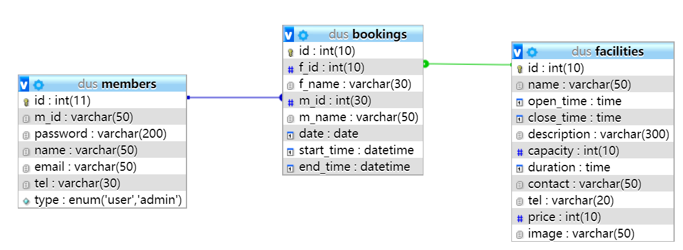
2.2 Database design

Slide 9




User Layer
2.3
Design
Strategy
Admin
User
Show Layer
Admin Page
User
Page
HTML, JavaScript(bootsrap), CSS
Application Layer
Account Recovery
Information Update
Login
Calendar View
Search/Book Facility
Facility Management
Register
PHP, JavaScript (moment & fullcalendar), CSS, PHPMailer
Data Exchange
Layer
DB_Connection.php
Data Store
Layer
DUS.sql
SQL

Slide 10
3.Testing

Slide 11
Main Testing
Function Testing(Black box)
  - Function Requirements
  - Equivalence Partitioning
Form testing
Database Testing
User Interface Testing
Compatibility Testing
Security Testing
Notes:
The details of testing shows in our testing report

Slide 12
Testing Report
Implement the most of function and non-function requirements
User-friendly interface and easy to operate
Improvement of database design
Improvement of security issue
Notes:
Improvement of database design: Many-to-many is not really good.

Slide 13
4.Conclusion

Slide 14
Conclusion
The project is based on Web Technology, and basically realized functions anticipated.
This project helps all team members have a good understanding of the phases of the internet based software development lifecycle and the importance of collaboration in the teamwork.

Slide 15
Reference
[1]Teruel et al., 2012. Analyzing the understandability of Requirements Engineering languages for CSCW systems: A family of experiments. Information and Software Technology, 54(11), pp.1215–1228.
[2]Lindoerfer&Mansmann, 2017. Enhancing requirements engineering for patient registry software systems with evidence-based components. Journal of Biomedical Informatics, 71, pp.147–153.
[3]OpenPlay, (2019). ‘OpenPlay’. Available at https://www.openplay.co.uk/ (Accessed 5 May 2019).
[4]PerfectGym, (2019). Club Member Self-service. Available at https://www.perfectgym.com/en (Accessed 6 May 2019).
[5]Queensland Government, (2017). Benefits of doing business online. Available at https://www.business.

